Slide 1



National Taiwan University
System Optimization Laboratory
Predictive Velocity Obstacle Method for Mobile Robot Motion Planning Among Dynamic Obstacles with Unknown Intentions

Slide 2
Introduction
Methods
Results
Discussion

Slide 3
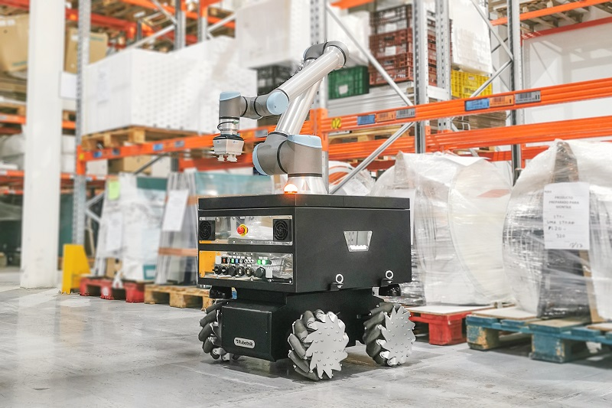

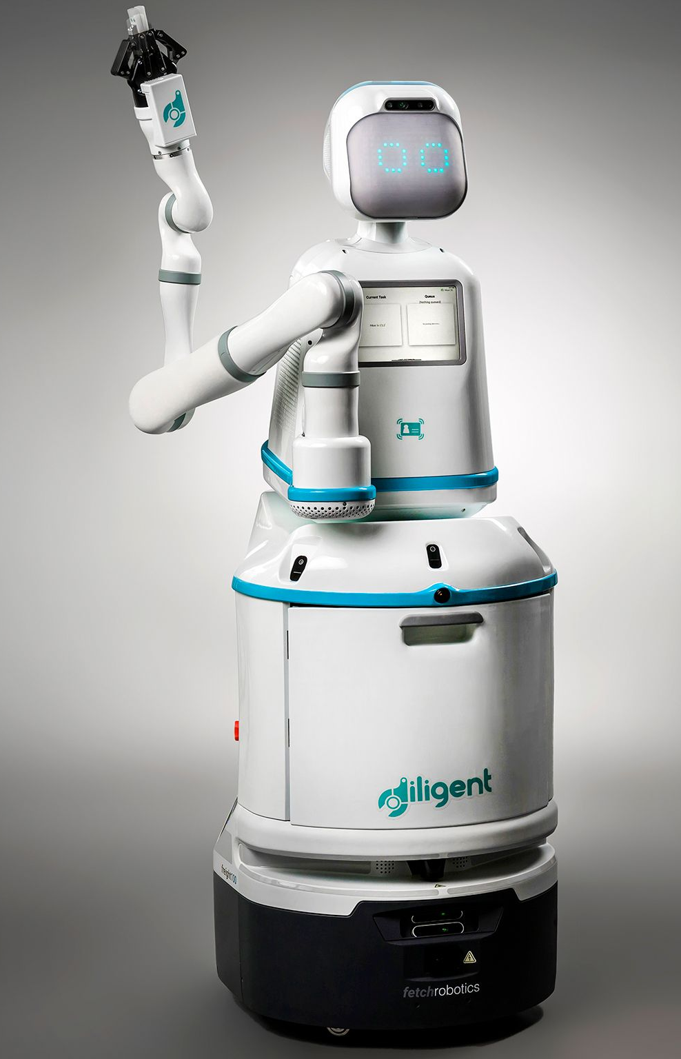


Autonomous Mobile Robots (AMR)
Motion Planning
Introduction
Methods
Results
Discussion
Notes:
As technology improves, there are more and more applications of autonomous mobile robots in different fields, such as in factories, logistics and hospitals. One of the biggest advantages of mobile robots is the ability to transport items and move automatically without direct human control. This not only saves on labor costs but also reduces so much tedious work that people have to do. Because of this, improving the autonomy of AMRs can greatly expand their use, allowing more people to benefit from their capabilities. So, to achieve this, I focus on Motion planning for AMRs, which plays a crucial role in enabling their autonomy.

Slide 4
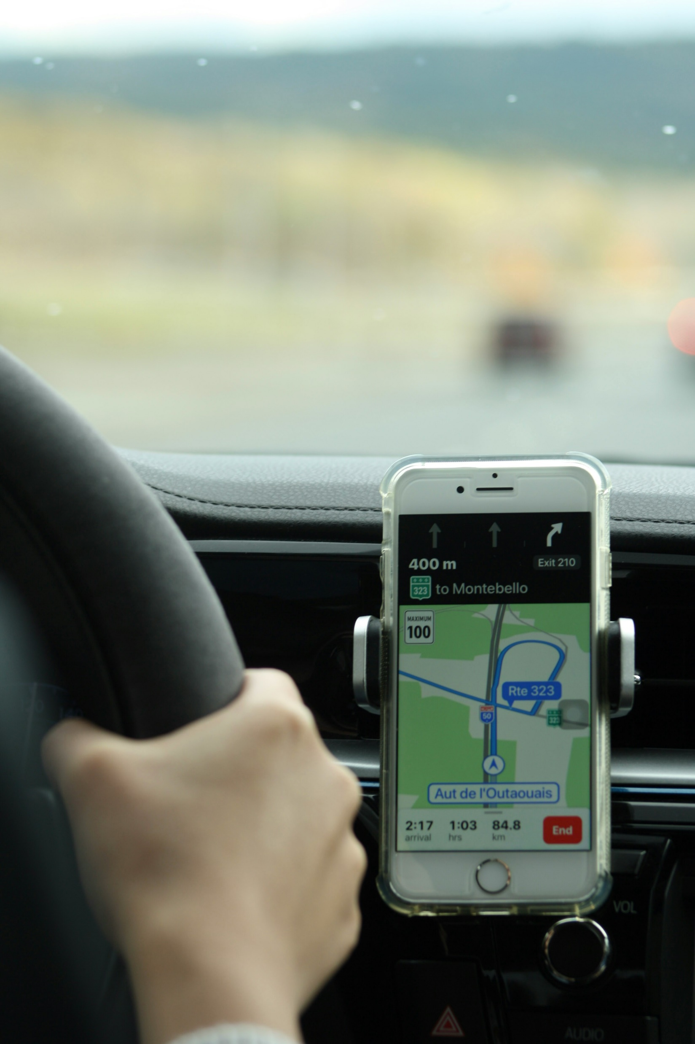
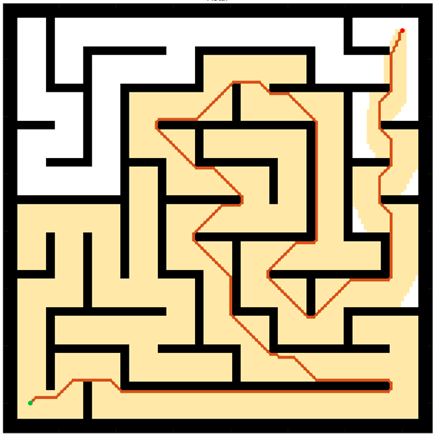
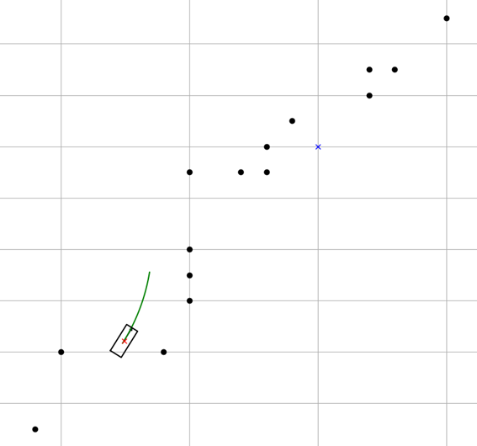
Motion Planning
Global Planning
Navigation
Avoiding Static obstacle
Local Planning
Handle emergency
Evading moving objects
Google Map
Global Planning
Driver
Local Planning
Introduction
Methods
Results
Discussion
Notes:
What is Motion planning in the field of robotics? Typically, it finds a continuous sequence of valid configurations that safely and efficiently guide a robot from start to goal. There are two critical parts: global planning and local planning. My research mainly focuses on local planning, but I need to introduce both first.
Global planning is like navigation in Google Maps; it creates a clear route from the starting point to the goal, telling robots how to avoid static obstacles.
On the other hand, local planning must handle all emergencies in real time. It generates a motion command in every short time period that helps robots evade dynamic objects, just like a driver constantly making decisions on the go. Therefore, a better local planning system should help AMRs navigate highly dynamic and complex environments, consequently improving their autonomy.

Slide 5
Methods of Local Planning
Dynamic Window Approach (DWA) samples obstacles’ positions in short time, but doesn’t consider obstacles’ velocity directly.
Artificial Potential Field (APF) could handle obstacles with movement, but needs calibration in each specific scenario.
To avoid dynamic obstacles with unknown-intention (non-cooperation) :
methods | advantage | disadvantage
Velocity Obstacle (VO) | Handles moving obstacles efficiently by taking their velocity into account. | Generate velocity command with huge variation when encounter non-linear movements.
Model Predictive Control (MPC) | Powerful in dealing with complex movement objects. Also consider robots’ dynamic. | Rely on the accuracy of long-term prediction. Computationally intensive.
Introduction
Methods
Results
Discussion
Notes:
There are several methods for solving local planning problems, such as Artificial Potential Fields (APF), Dynamic Window Approach (DWA), Velocity Obstacles (VO), and Model Predictive Control (MPC). Among these, VO and MPC are considered the most effective for robots to evade continuously moving obstacles, but both have their drawbacks.
The VO method assumes that every dynamic object moves with a constant speed and heading, making it difficult to handle obstacles without prior knowledge of their intentions. On the other hand, the MPC method allows robots to avoid nonlinear velocity obstacles by planning over a long-term future. However, this approach is computationally intensive, and its long-term predictions about obstacle movements can still be inaccurate.
Therefore, my research aims to combine the VO method with the concept of MPC, seeking to reduce their disadvantages and enhance the avoidance capabilities of AMRs.

Slide 6
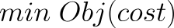
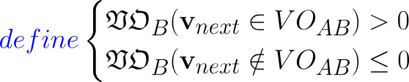
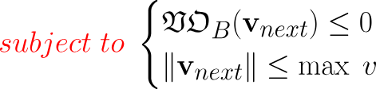

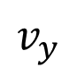
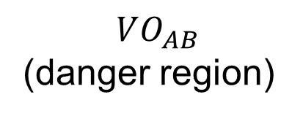
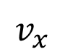
Conventional VO method
Design variables: $v_{next}$
Velocity space
$$v_{y}$$
$$VO_{AB}$$
(danger region)
Dynamic feasible region
Ideal velocity
$$v_{x}$$
Optimal robot’s next step
Introduction
Methods
Results
Discussion
Notes:
首先讓我們來介紹一下傳統的VO方法，基本上這個方法就是不斷地決定機器人下一步的速度向量然後移動，接著再決定下一步，如此不斷循環。
怎麼決定這個速度向量呢? 這個演算法的核心，是想要讓機器人在閃避障礙物的同時，仍然朝目標以最快的方式前進，而這就成為一個最佳化問題。
所以，最佳化的設計變數就會是機器人下一步的速度向量v_next。而我們有一個已知的理想速度v_ideal，這個理想速度是機器人在沒有其他限制下能朝目標最快速前進的速度向量。最佳化的目標函式，就是去最小化機器人的下一步與理想速度的差異。
而限制式的部分可以看到右手邊的這張圖，這張圖代表著機器人的速度空間。圓圈範圍內是考慮了機器人的最大速度限制後，實際的可行區域。而紅色範圍則是危險區域，象徵著一旦機器人的速度向量落入該區，便有可能發生碰撞。
所以，我定義一個VO函數，一旦速度向量落於危險區域內，函數值便大於0；反之，則小於等於0。於是這個最佳化的限制式，就可被寫為: v_next必須小於最大速度，且VO函數的值必須小於等於0。至於這個危險區域該怎麼定義，我下一張投影片會介紹。
Firstly, let me introduce the Velocity Obstacle method. Basically, what this approach does is continuously determine the optimal velocity for the robot to move on.
Conventional VO method has constructed an optimization problem to find the best motion. The design variable “v_next” is the robot’s next motion which the algorithm has to find. We want the robot’s movement to avoid obstacles while still progressing toward its goal. Therefore, this optimal vector must be as close to ideal velocity as possible and lie in the feasible region but stay outside the danger space, as you can see in this picture. The VO block means the danger region, which will be explained more in the following slide. What the algorithm does here is define a VO constraint function. If a motion falls within the VO region, the function's value will be greater than zero, indicating a potential collision. The optimization problem is therefore subject to the condition that the function value must be less than zero. Thus, once the problem is solved, the optimal motion for the robot’s next step will ensure collision-free and closer to the goal point.

Slide 7
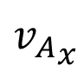
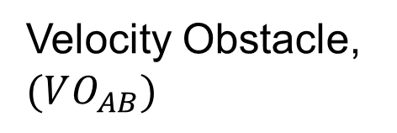
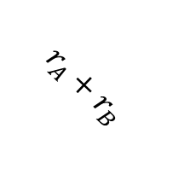
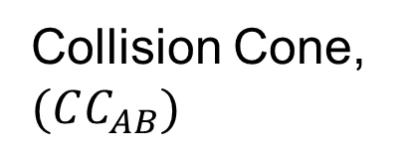
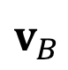
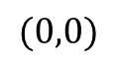
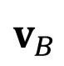
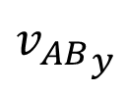
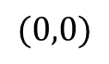
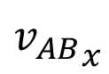
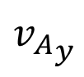
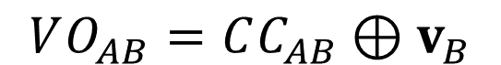
Velocity Obstacle (VO)
$$VO_{AB}=CC_{AB}⊕v_{B}$$
C-space
Velocity space
$${v_{AB}}_{y}$$
$${v_{A}}_{y}$$
Collision Cone, $(CC_{AB})$
Velocity Obstacle, $(VO_{AB})$
$$v_{B}$$
$$r_{A}+r_{B}$$
object B
$${v_{AB}}_{x}$$
$${v_{A}}_{x}$$
$$(0,0)$$
$$(0,0)$$
$$v_{B}$$
agent A (Robot)
Introduction
Methods
Results
Discussion
Notes:
假設機器人為節點A，當它遭遇了一個物體B，我們可以定義一個A的危險動作動作集合。
怎麼做呢? 直覺上，在configuration space 也就是 C-space 上幫障礙物長出膨脹層後，我們可以從機器人的中心對著膨脹層做兩切線。這個錐形區域便代表著節點A朝著這範圍內的方向移動，都有可能造成與B相撞。
接著，我們轉換一下視角，把這個錐形區域歸納進機器人的速度空間中。現在，這個範圍象徵著所有可能造成AB碰撞的相對速度v_AB集合。而這個區域又可被稱為碰撞錐，collision cone。
當B的速度為0，v_AB這相對速度本身就是機器人的速度。但是，當障礙物本身有速度，而我們又想值觀地知道節點A究竟有那些速度向量是危險的話，便需要將這個碰撞錐平移。
平移的方式，是將這個區域的元素，通通加上v_B向量。而得到的這個新範圍便稱為Velocity Obstacle，也就是VO，代表著所有會造成碰撞的v_A速度。我們應該避免選擇這個範圍內的速度向量作為機器人下一步的動作。
How to form a VO region in a robot’s velocity space? Let's take agent A as a robot and object B as an obstacle for example. If an agent A encounters an object B, we can identify a danger region for A's movement. How? Intuitively, we draw two tangent lines from A's center to the inflation circle of object B in the configuration space. This forms a sector region indicating that moving in this direction would be dangerous for agent A.
Next, we change our perspective. By mapping this sector into the velocity space, the region now represents the set of relative velocities that would lead to a collision. This is known as the Collision Cone.
When object B has its own velocity, we need to determine which motions for A are safe or dangerous. To do this, we compute the Minkowski sum of the Collision Cone and B's velocity vector. The resulting region indicates all the dangerous motions for agent A and is referred to as the Velocity Obstacle.

Slide 8
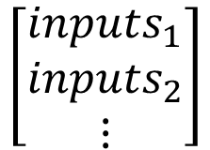
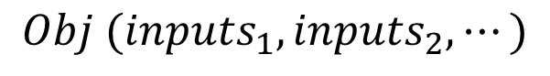
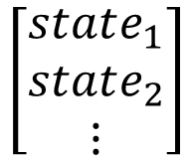
Concept of MPC
1
$$Obj (inputs_{1}, inputs_{2},⋯)$$
minimizing energy usage
moving closer to target state
Optimization problem → add constraints!!
$$\left[\begin{matrix}inputs_{1} \\ inputs_{2} \\ ⋮\end{matrix}\right]$$
System Model
$$\left[\begin{matrix}state_{1} \\ state_{2} \\ ⋮\end{matrix}\right]$$
2
Real System
Find solution → Apply only the 1st control action to
3
Update
System Model
Introduction
Methods
Results
Discussion
Notes:
我簡短介紹一下model predictive control。最重要的一點是，MPC會運用數學模型去預測自身系統未來一段時間內的狀態。比方說我開車在路上，如果給定一序列的油門、煞車、轉向等控制輸入，10秒內我每一個時間點的車輛位置會出現在哪?
我們首先會將一連串隨時間排序的控制輸入當設計變數，並且定義一個符合自身目的的目標函數，比方說最小化能源消耗，或最貼近目標等等。並且，我們可以施加限制式以符合系統動態，像是速度限制或是預防碰撞等等。
接著，一旦最佳化得到結果，MPC便將這最佳控制序列的第一組，也就是下一刻的動作，輸入給系統。
然後，我們便量測系統的真實狀態，以更新數學預測模型，並且再回到步驟一繼續執行下一步的最佳化。如此不斷循環這個流程。
I’ll briefly introduce the concept of Model Predictive Control. Essentially, MPC uses a mathematical model to predict the future behavior of a system over a specified horizon—for example, a few seconds into the future.
First, we define an objective function that reflects the control goal, such as minimizing energy usage or moving closer to a target state. Since MPC is an optimization problem, we can also add constraints to ensure the solution follows system limitations, like speed limits or obstacle avoidance.
Once the optimal control sequence is solved, only the first control action is applied to the real system. After executing this action, we measure the current state of the system, update the model, and repeat the optimization process again in the next period.
So this is a cycle. We keep doing this until the system reach its goal stably.
(Because MPC evaluates a sequence of control inputs over time and incorporates constraints, it is highly adaptive and is considered a powerful method for handling complex problems, such as dynamic environments or systems with multiple constraints.)

Slide 9
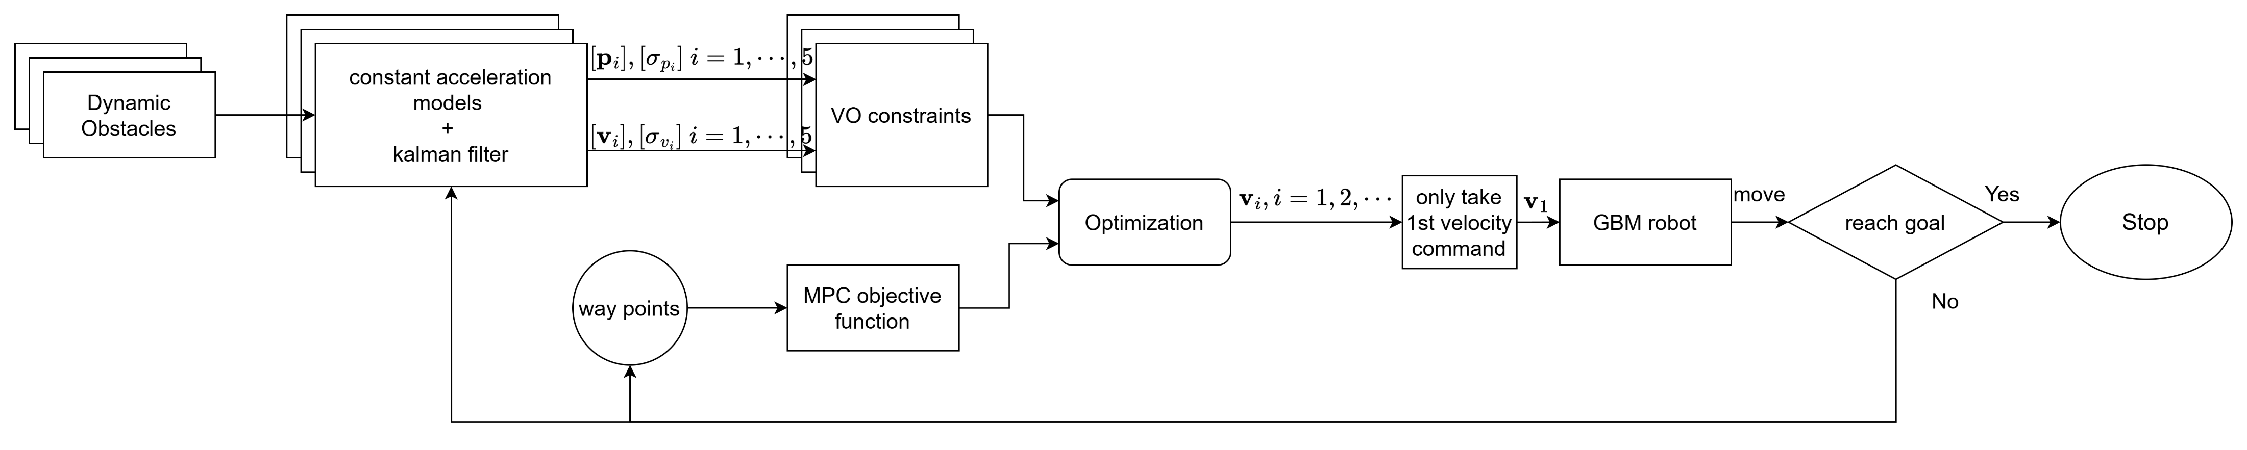
Structure of Proposed Method
Prediction step
Optimization step
Introduction
Methods
Results
Discussion
Notes:
The proposed method is somewhat similar to MPC’s structure. I seek to determine the optimal sequence of motion commands within a short time horizon to handle different obstacles. This process is structured into two key components: Prediction and Optimization. The Prediction section will estimate the obstacles’ future states. The following optimization should take those as the constraints and generate robots’ next step motions. I will explain more in the following slides.

Slide 10
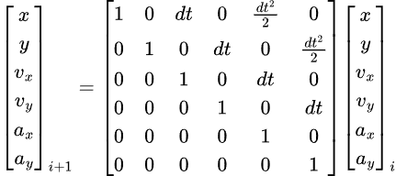
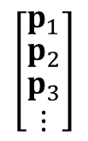
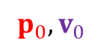
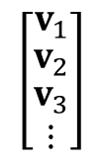
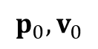

Prediction
$$p_{i},v_{i}, i=1,2,3…$$
$$p_{0},v_{0}$$
Dynamic obstacle
Kalman Filter
Prediction
Constant Velocity model
Observation
$$\left[\begin{matrix}p_{1} \\ \begin{matrix}p_{2} \\ \begin{matrix}p_{3} \\ ⋮\end{matrix}\end{matrix}\end{matrix}\right]$$
$$\left[\begin{matrix}v_{1} \\ \begin{matrix}v_{2} \\ \begin{matrix}v_{3} \\ ⋮\end{matrix}\end{matrix}\end{matrix}\right]$$
,
$$p_{0},v_{0}$$
+
noise
&
Variance (confidence)
Introduction
Methods
Results
Discussion
Notes:
In the prediction step, we aim to estimate the movements of surrounding obstacles. To achieve this, I assume that the positions and velocities of all obstacles can be measured and model each observed obstacle as a constant acceleration agent, meaning they maintain the same acceleration over a short time period.
(and) For evaluation, a Kalman Filter is applied to estimate the confidence level of this prediction. Typically, the longer the prediction horizon, the greater the uncertainty, leading to higher variance in the estimates. Consequently, this expands the estimated danger region of the obstacle as in this picture.
(The farther into the future the prediction extends, the larger the predicted uncertainty.)

Slide 11
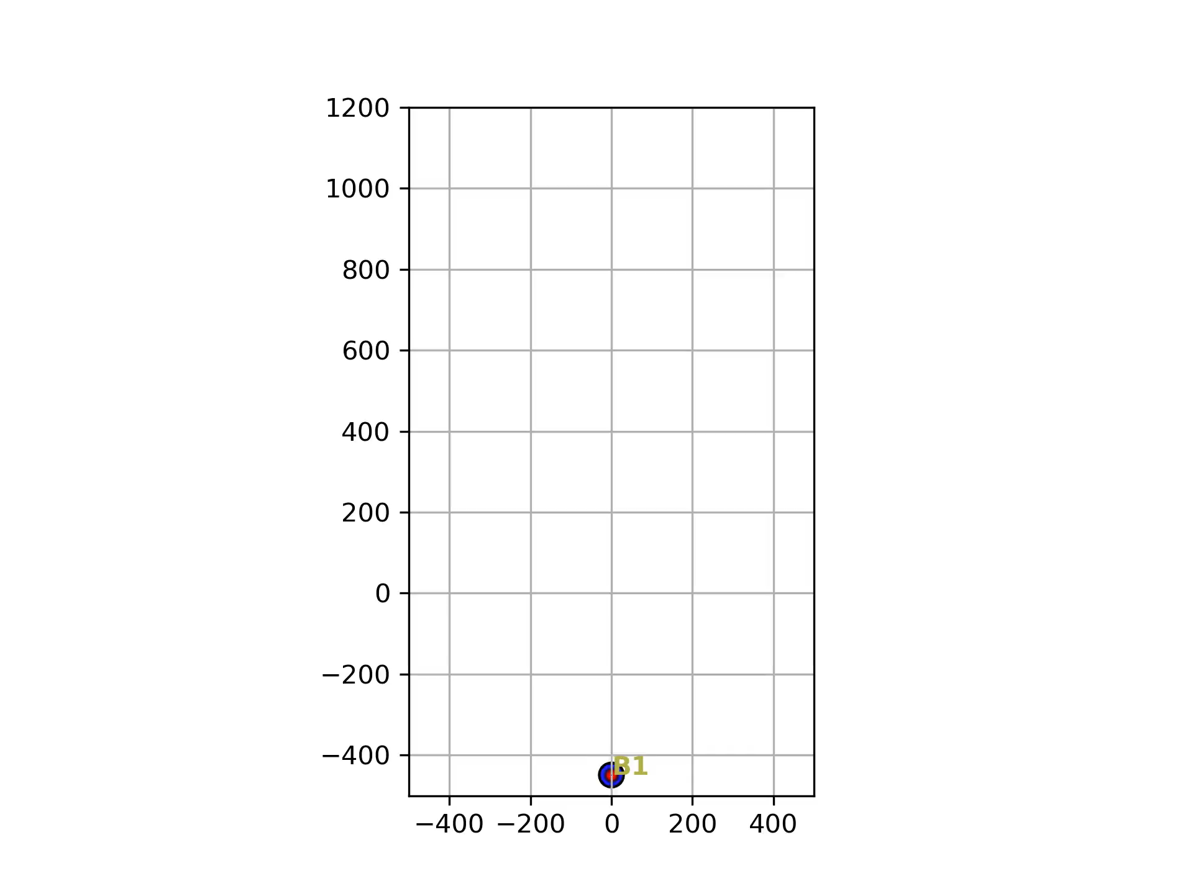

Prediction
$$p_{i},v_{i}, i=1,2,3…$$
$$p_{0},v_{0}$$
Dynamic obstacle
Introduction
Methods
Results
Discussion
Notes:
In the prediction step, we aim to estimate the movements of surrounding obstacles. To achieve this, I assume that the positions and velocities of all obstacles can be measured and model each observed obstacle as a constant acceleration agent, meaning they maintain the same acceleration over a short time period.
(and) For evaluation, a Kalman Filter is applied to estimate the confidence level of this prediction. Typically, the longer the prediction horizon, the greater the uncertainty, leading to higher variance in the estimates. Consequently, this expands the estimated danger region of the obstacle as in this picture.
(The farther into the future the prediction extends, the larger the predicted uncertainty.)

Slide 12
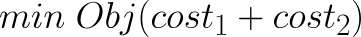
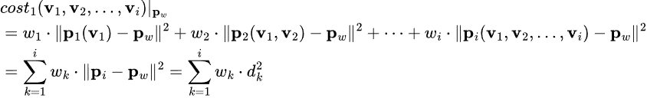
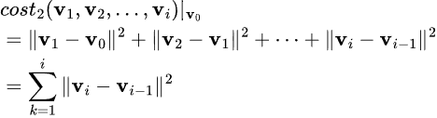
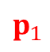
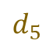


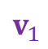
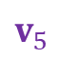
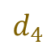
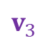

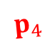
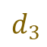

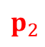
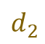
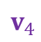
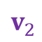
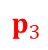
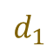
Optimization
$$p_{0}$$
Robot
$$v_{1}$$
$$p_{1}$$
Design variables: $v_{1},v_{2},v_{3},…,v_{i}$
$$v_{2}$$
$$p_{2}$$
Way point distances
$$v_{3}$$
$$p_{3}$$
$$d_{1}$$
$$v_{4}$$
$$d_{2}$$
$$p_{4}$$
$$d_{3}$$
$$v_{5}$$
Velocity change
$$p_{5}$$
$$d_{4}$$
$$d_{5}$$
Way point${ p}_{w}$
Introduction
Methods
Results
Discussion
Notes:
Unlike the conventional VO method, which only determines the next step motion for the AMR, my approach aims to optimize a sequence of velocity vectors over a time horizon, which means that the design variables could be: V1, V2 until Vi.
The objective function consists of two types of cost:
The waypoint distance cost is the sum of distances between the robot’s position at each time step and its corresponding waypoint. Minimizing this could encourage the robot to move efficiently toward its goal.
In addition, the velocity change cost reduces extreme or abrupt motions. This cost penalizes large changes in velocity between consecutive time steps. Minimizing this should make a set of smooth and continuous motions.
By combining these two costs, the objective is to strike a balance between motion efficiency and continuity, ensuring the robot reaches its goal smoothly.

Slide 13










Constraints
Velocity space: $v_{1}$
$$VO_{AB,1}$$
Design variables: $v_{1},v_{2},v_{3},…,v_{i}$
Velocity space: $v_{2}$
$$VO_{AB,2}$$
Velocity space: $v_{3}$
$$VO_{AB,3}$$
Velocity space: $v_{i}$
.
.
.
$$VO_{AB,i}$$
Introduction
Methods
Results
Discussion
Notes:
To ensure that an AMR avoids collisions with obstacles, constraints are applied to the optimization process. The basic idea is to let the robot’s motion at each time step stays outside the corresponding VO region.
The most complex part is constructing the VO constraint function. The robot’s current position and the state of obstacles are treated as parameters. However, when optimizing a sequence of motions over a time horizon, the robot’s future positions also become variables—they depend on the motion choices made in the previous time steps.
As the prediction horizon becomes longer, the dimensionality of the optimization increases, which can significantly slow down computation. Therefore, finding a reasonable prediction horizon is crucial for balancing accuracy and computational efficiency in this approach.

Slide 14





Tested Holonomic Robot
Assumptions:
Perfect control
Consider a linear TN-curve of motors (acceleration constraints & maximum velocity limit)
The confronted tire forces will balance out
GBM
Linear TN-curve
Acc constraints & $v_{max}⁡$
Introduction
Methods
Results
Discussion
Notes:
To test my proposed method, I applied it to a specific type of mobile robot called Generalized Bicycle Mode or the GBM. The GBM has a unique design. Unlike regular vehicles that steer by turning the front wheel, the GBM has two wheels that can rotate and spin independently. This design allows it to move in any direction without changing its orientation—just as you can see in this picture! This flexibility makes the GBM highly maneuverable.

Slide 15



Experiments
(Scenario 1) Confront with a constant velocity obstacle | (Scenario 2) Confront with a constant acceleration obstacle | (Scenario 3) Confront with two types of obstacles | (Scenario 4) Pass by five SHM obstacles
Simple Harmonic Motion
constant velocity
constant acceleration
constant acceleration
constant velocity
Assumptions:
All objects are assumed to be detected perfectly; however, Gaussian-distribution noise is added to simulate realistic sensor errors.
In cases where the optimization fails or returns no valid solution, the robot is assumed to halt for safety.
Algorithms’ run time is ignored.
Introduction
Methods
Results
Discussion
Notes:
To see how well this algorithm works, I ran a simulation on the computer. In this experiment, the GBM had one simple mission: move from point A to point B. Along the way, it encountered dynamic obstacles moving across in a S-shaped trajectory. The robot’s job was to avoid these objects and still reach its goal.
After testing the proposed approach and comparing it to the conventional VO method, two significant results were observed: First, the proposed method successfully guided the robot to its destination without collisions. Second, compared to the existing method, the new approach reduced the total travel time, indicating improved efficiency.

Slide 16




How to Evaluate?
Methods to evaluate the continuity of velocity commands:
Command variation $V_{cmd}$
Maximum command difference $∆cmd_{max}$
Evaluating range
$$V_{cmd}=\sum_{i}{||v_{i}−v_{i−1}||}$$
v(cm/s)
t(seconds)
$$∆cmd_{max}=\max{(||v_{i}−v_{i−1}||)}$$
Introduction
Methods
Results
Discussion
Notes:
To test my proposed method, I applied it to a specific type of mobile robot called Generalized Bicycle Mode or the GBM. The GBM has a unique design. Unlike regular vehicles that steer by turning the front wheel, the GBM has two wheels that can rotate and spin independently. This design allows it to move in any direction without changing its orientation—just as you can see in this picture! This flexibility makes the GBM highly maneuverable.

Slide 17





Results
 | Scenario 1 |  | Scenario 2 |  | Scenario 3 |  | Scenario 4
Method | VO | new | VO | new | VO | new | VO | new
Average Total time (seconds) | 16.584 | 16.356 | 16.581 | 16.394 | 16.629 | 16.488 | 18.253 | 18.399
${\overline{V}}_{cmd}$ (cm/s) | 195.094 | 109.533 | 200.259 | 117.400 | 226.643 | 130.980 | 481.397 | 474.289
$\max{∆cmd_{max}}$ (cm/s) | 67.402 | 9.951 | 67.943 | 13.645 | 49.335 | 13.958 | 21.528 | 13.369
Introduction
Methods
Results
Discussion
Notes:
To see how well this algorithm works, I ran a simulation on the computer. In this experiment, the GBM had one simple mission: move from point A to point B. Along the way, it encountered dynamic obstacles moving across in a S-shaped trajectory. The robot’s job was to avoid these objects and still reach its goal.
After testing the proposed approach and comparing it to the conventional VO method, two significant results were observed: First, the proposed method successfully guided the robot to its destination without collisions. Second, compared to the existing method, the new approach reduced the total travel time, indicating improved efficiency.

Slide 18



Experiment 2 — extreme scenario
Conventional VO
Proposed method
GBM2
GBM1
Constant acceleration
Introduction
Methods
Results
Discussion
Notes:
To see how well this algorithm works, I ran a simulation on the computer. In this experiment, the GBM had one simple mission: move from point A to point B. Along the way, it encountered dynamic obstacles moving across in a S-shaped trajectory. The robot’s job was to avoid these objects and still reach its goal.
After testing the proposed approach and comparing it to the conventional VO method, two significant results were observed: First, the proposed method successfully guided the robot to its destination without collisions. Second, compared to the existing method, the new approach reduced the total travel time, indicating improved efficiency.

Slide 19
Contribution
This research proposes an obstacles-avoidance method that can handle unknown intentions effectively:
Comparing to VO | Comparing to MPC
Improve the continuity of velocity commands. The algorithm is adaptable to non-linear velocity obstacles. | Take obstacles’ velocity into consideration. No need to rely on long-term prediction, reduce the accuracy demand.
Introduction
Methods
Results
Discussion
Notes:
Here is why this research matters: it proposes an obstacles-avoidance method that can handle unknown intentions effectively.
However, there are still a couple of things that need to be done. First, I need to adjust the prediction horizon or modify the step length based on the accuracy of the predictions.
Next, I plan to test the algorithm in more diverse scenarios, including adding more dynamic obstacles to the simulations and making their movements highly irregular.

Slide 20
Future works
Adjust the predictive horizon or modify the step length based on the accuracy of the predictions.
Add more dynamic obstacles to the simulations.
Make people-like or car-like movements for dynamic obstacles.
Low Accuracy
High Accuracy
People-like Movements
More Obstacles
Introduction
Methods
Results
Discussion
Notes:
Here is why this research matters: it proposes an obstacles-avoidance method that can handle unknown intentions effectively.
However, there are still a couple of things that need to be done. First, I need to adjust the prediction horizon or modify the step length based on the accuracy of the predictions.
Next, I plan to test the algorithm in more diverse scenarios, including adding more dynamic obstacles to the simulations and making their movements highly irregular.

Slide 21
National Taiwan University
System Optimization Laboratory
Predictive Velocity Obstacle Method for Mobile Robot Motion Planning Among Dynamic Obstacles with Unknown Intentions

Slide 22
Motion Planning
Motion Planning finds a continuous sequence of valid configurations that safely and efficiently guide a robot from start to goal.
Global Planning
Navigation
Avoiding Static obstacle
Local Planning
Handle emergency
Evading moving objects
Google Map
Global Planning
Driver
Local Planning
Introduction
Methods
Results
Discussion
Notes:
What is Motion planning in the field of robotics? Typically, it finds a continuous sequence of valid configurations that safely and efficiently guide a robot from start to goal. There are two critical parts: global planning and local planning. My research mainly focuses on local planning, but I need to introduce both first.
Global planning is like navigation in Google Maps; it creates a clear route from the starting point to the goal, telling robots how to avoid static obstacles.
On the other hand, local planning must handle all emergencies in real time. It generates a motion command in every short time period that helps robots evade dynamic objects, just like a driver constantly making decisions on the go. Therefore, a better local planning system should help AMRs navigate highly dynamic and complex environments, consequently improving their autonomy.

Slide 23




Local Planning
[1] Polvara, Riccardo, et al. "Obstacle avoidance approaches for autonomous navigation of unmanned surface vehicles." The Journal of Navigation 71.1 (2018): 241-256.
[3] Du Toit, N. E. and J. W. Burdick (2010). Robotic motion planning in dynamic, cluttered, uncertain environments. 2010 IEEE International Conference on Robotics and Automation, IEEE.
[2] Wu, C.-H. and K.-Y. Chan (2024). "Developing a dynamic obstacle avoidance system for autonomous mobile robots using Bayesian optimization and object tracking: Implementation and testing." Proceedings of the Institution of Mechanical Engineers, Part C: Journal of Mechanical Engineering Science 238(9): 4007-4022.
Artificial Potential Fields (APF) | Dynamic Window Approach (DWA) | Velocity Obstacles (VO) | Model Predictive Control (MPC)
Simple for real-time avoidance | Effective, Dynamic feasible | Deal with multi-agents systems | Handles robot dynamics
Local minima issue | Struggle with moving obstacles | Poor at handling unknow intensions | Computationally expensive
[1]
[3]
[2]
former lab members’ research
My research want to use
Introduction
Methods
Results
Discussion
Notes:
There are several methods for solving local planning problems, such as Artificial Potential Fields (APF), Dynamic Window Approach (DWA), Velocity Obstacles (VO), and Model Predictive Control (MPC). Among these, VO and MPC are considered the most effective for robots to evade continuously moving obstacles, but both have their drawbacks.
The VO method assumes that every dynamic object moves with a constant speed and heading, making it difficult to handle obstacles without prior knowledge of their intentions. On the other hand, the MPC method allows robots to avoid nonlinear velocity obstacles by planning over a long-term future. However, this approach is computationally intensive, and its long-term predictions about obstacle movements can still be inaccurate.
Therefore, my research aims to combine the VO method with the concept of MPC, seeking to reduce their disadvantages and enhance the avoidance capabilities of AMRs.

Slide 24


Introduction of Path Planning
B
A
Global Planning
Local Planning
Introduction
Methods
Results
Discussion

Slide 25
Conventional VO method
robot
Velocity command by VO method
Introduction
Methods
Results
Discussion
Notes:
Firstly, let me introduce the Velocity Obstacle method. Basically, what this approach does is continuously determine the optimal velocity for the robot to move on.
Conventional VO method has constructed an optimization problem to find the best motion. The design variable “v_next” is the robot’s next motion which the algorithm has to find. We want the robot’s movement to avoid obstacles while still progressing toward its goal. Therefore, this optimal vector must be as close to ideal velocity as possible and lie in the feasible region but stay outside the danger space, as you can see in this picture. The VO block means the danger region, which will be explained more in the following slide. What the algorithm does here is define a VO constraint function. If a motion falls within the VO region, the function's value will be greater than zero, indicating a potential collision. The optimization problem is therefore subject to the condition that the function value must be less than zero. Thus, once the problem is solved, the optimal motion for the robot’s next step will ensure collision-free and closer to the goal point.

Slide 26

Structure of proposed method
Prediction step
Optimization step
Introduction
Methods
Results
Discussion
Notes:
The proposed method is somewhat similar to MPC’s structure. I seek to determine the optimal sequence of motion commands within a short time horizon to handle different obstacles. This process is structured into two key components: Prediction and Optimization. The Prediction section will estimate the obstacles’ future states. The following optimization should take those as the constraints and generate robots’ next step motions. I will explain more in the following slides.

Slide 27










Optimization step
Minimize
Way point distances
Objective Function (design variable: $v_{i}, i=1,2,3…$)
= ∑ way point distances + ∑ change amount of velocity
Subjected to:
Velocity Obstacles
Way point
Change amount of velocity
$$d_{5}$$
$$d_{4}$$
Optimization step
$${||∆v}_{i}||$$
$$d_{3}$$
$$d_{2}$$
$$v_{i}$$
$$d_{1}$$
$$v_{i−1}$$
Robot
Velocity space
Introduction
Methods
Results
Discussion

Slide 28



Tested AMR
Generalized Bicycle Model
2 wheels that can rotate and spin independently
Holonomic robot (heading and orientation are decoupled)
rotate
rear wheel
Front wheel
spin
Introduction
Methods
Results
Discussion
Notes:
To test my proposed method, I applied it to a specific type of mobile robot called Generalized Bicycle Mode or the GBM. The GBM has a unique design. Unlike regular vehicles that steer by turning the front wheel, the GBM has two wheels that can rotate and spin independently. This design allows it to move in any direction without changing its orientation—just as you can see in this picture! This flexibility makes the GBM highly maneuverable.

Slide 29








Optimization step -- VO
$$v_{y}$$
$$v_{y}$$
Collide in $τ$ seconds → danger
$$VO_{AB}$$
$$VO_{AB}^{τ}$$
Collide after $τ$ seconds → relatively safe
Ideal velocity
Cut off the relatively safe region
Dynamic feasible region
$$v_{x}$$
$$v_{x}$$
Introduction
Methods
Results
Discussion

